Slide 1

HBASE and HIVE
COMP 1702 Big Data
Lecture 6

Slide 2
What is HBase
….. is an open-source column-oriented non-relational distributed database modeled after Google's Bigtable and written in Java.

Slide 3
HBase Background
Google releases paper on Bigtable – 2006
First usable HBase – 2007
HBase becomes Apache project – 2010

Slide 4
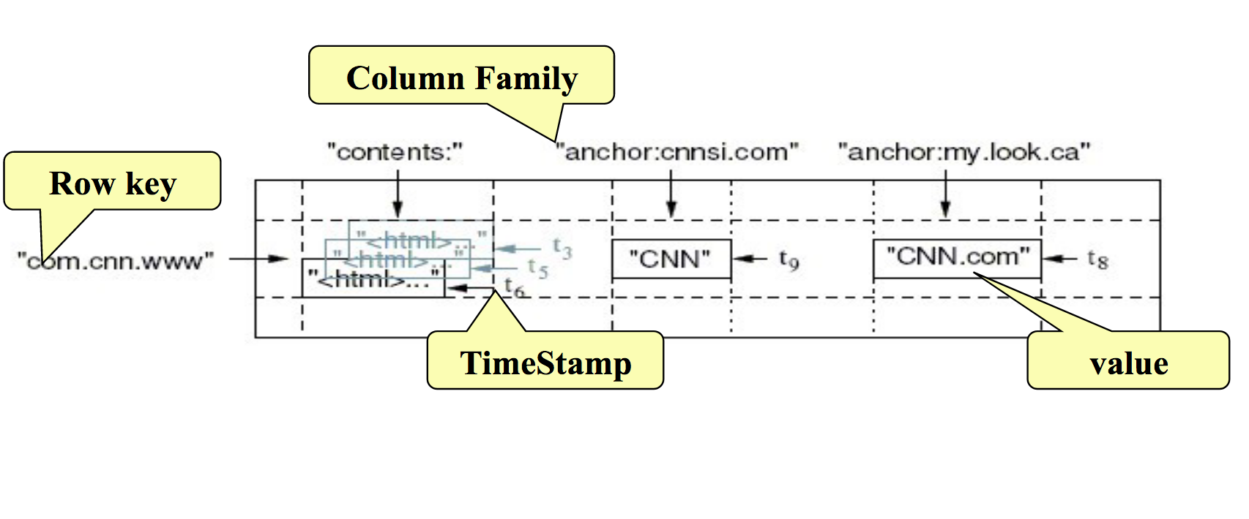
BigTable Data Model
HBase’s Data Model is similar

Slide 5
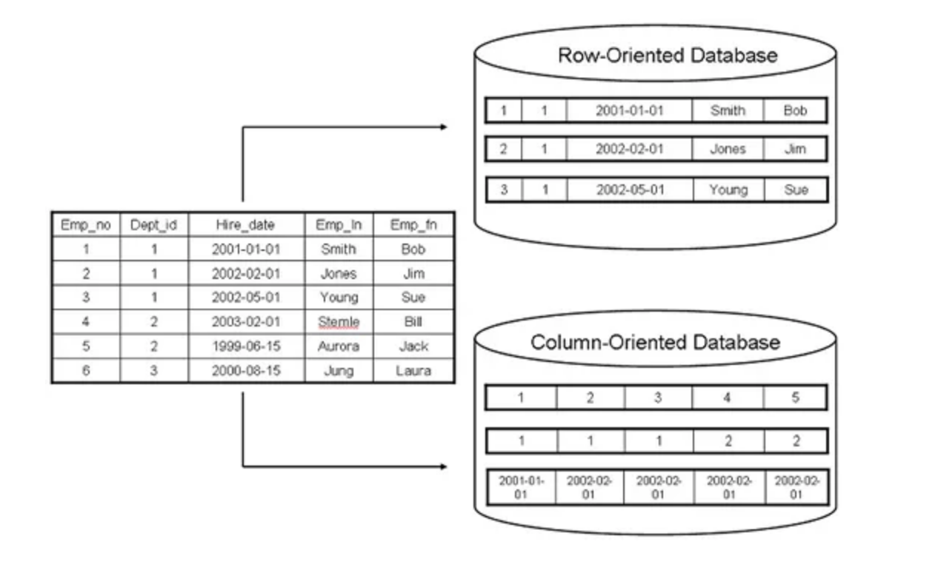
Row-oriented vs column-oriented Databases
Column-oriented databases benefits
High performance on aggregation queries (like COUNT, SUM, AVG, MIN, MAX)
Highly efficient data compression and/or partitioning
True scalability and fast data loading for Big Data
Accessible by many 3rd party BI analytic tools
Fairly simple systems administration

Slide 6
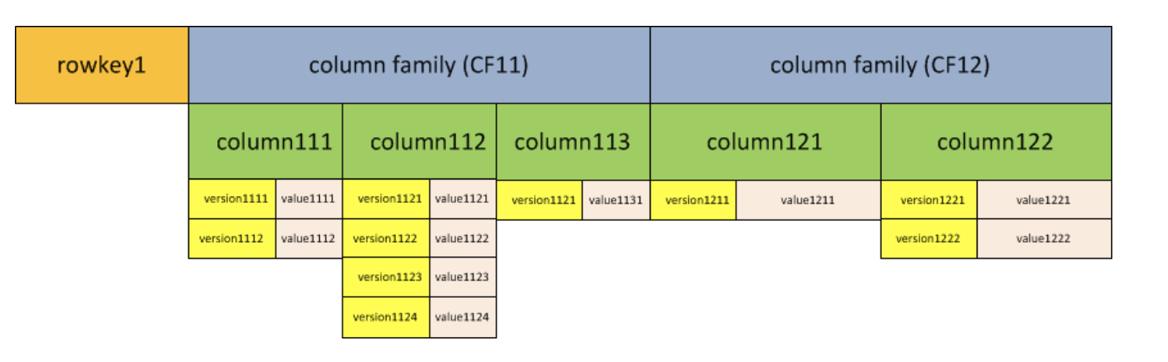
Data Organization in HBase
All data is stored in Tables
Table rows have exactly one Key, and all rows in a table are physically ordered by key
Tables have a fixed number of Column Families
Each row can have many Columns in each column family
Each column has a set of values, each with a timestamp
Each <rowkey, column family, column, timestamp> combination represents coordinates for a Cell (Value)

Slide 7
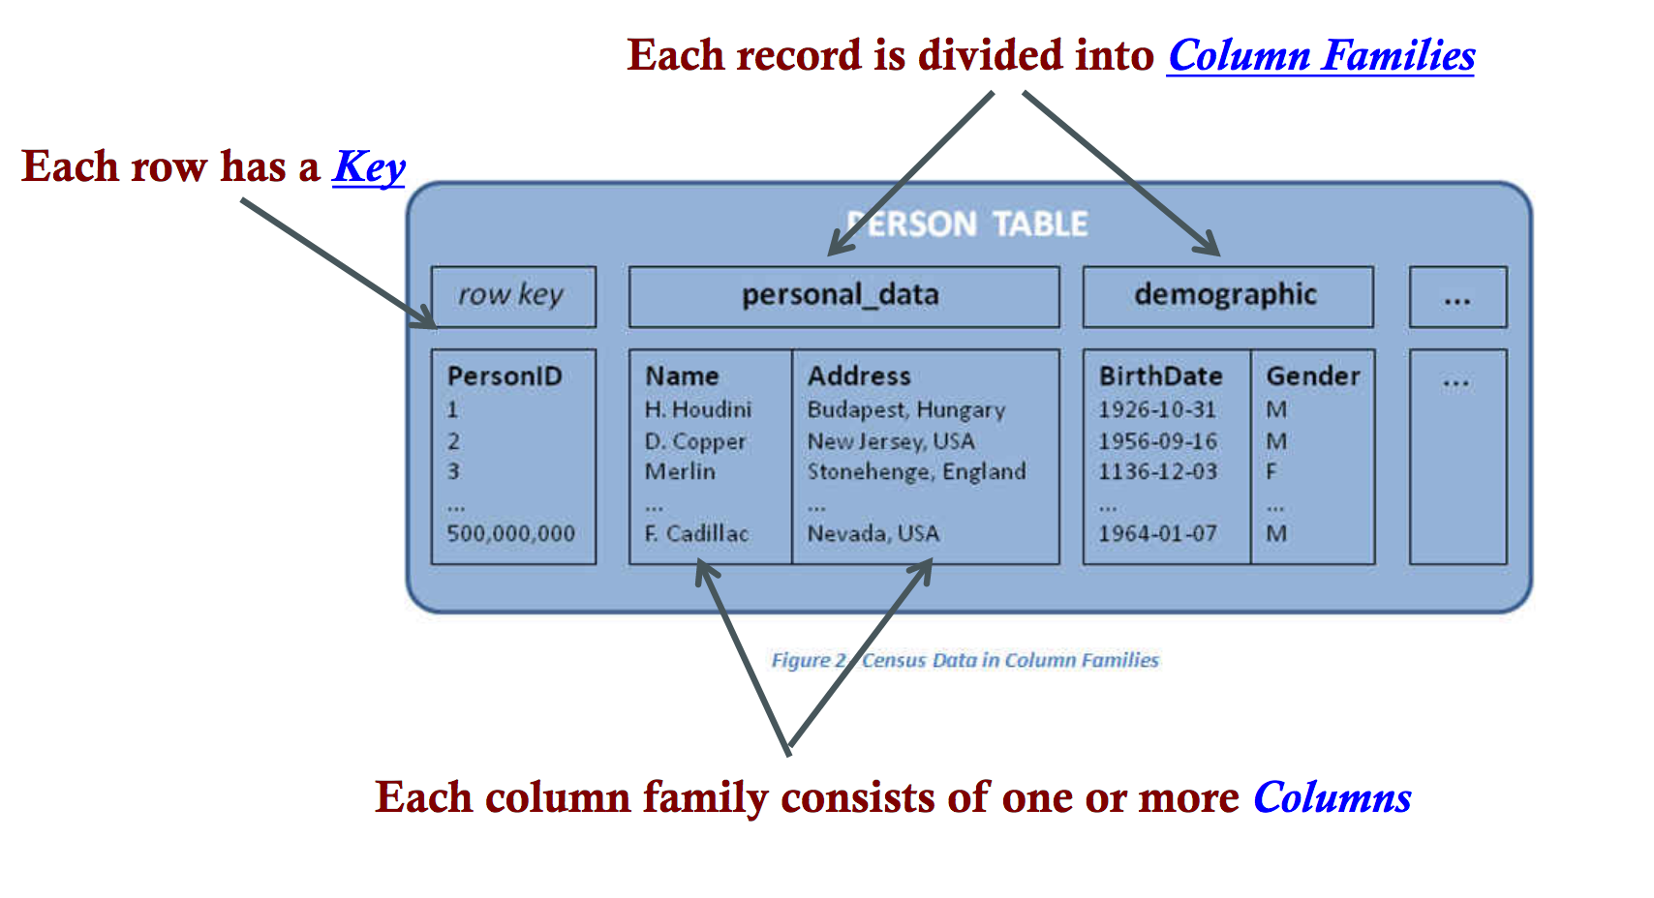
Example: Keys and Column Families

Slide 8
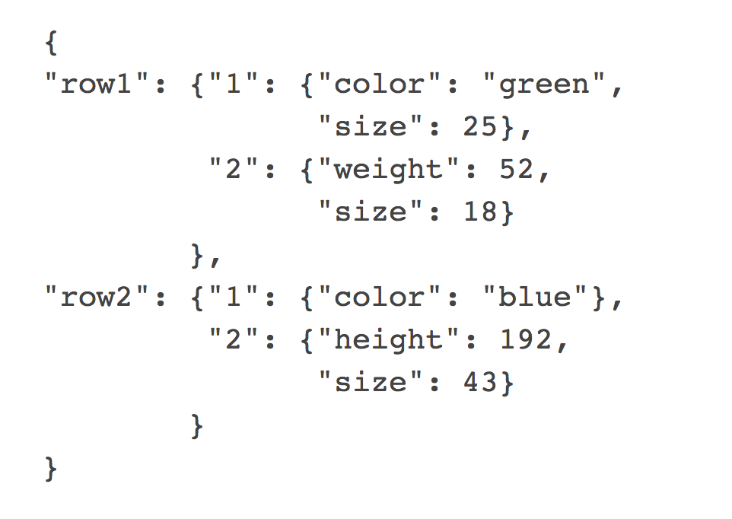
What is a Column Family?
A Column Family is a group of related columns
impossible or difficult to change later
All columns must be in a column family
Each row can have a completely different set of columns for a column family

Slide 9
Column
A column is identified by column family and column qualifier separated by a colon character (:)
E.g. courses:math
Column qualifiers do not have data types

Slide 10
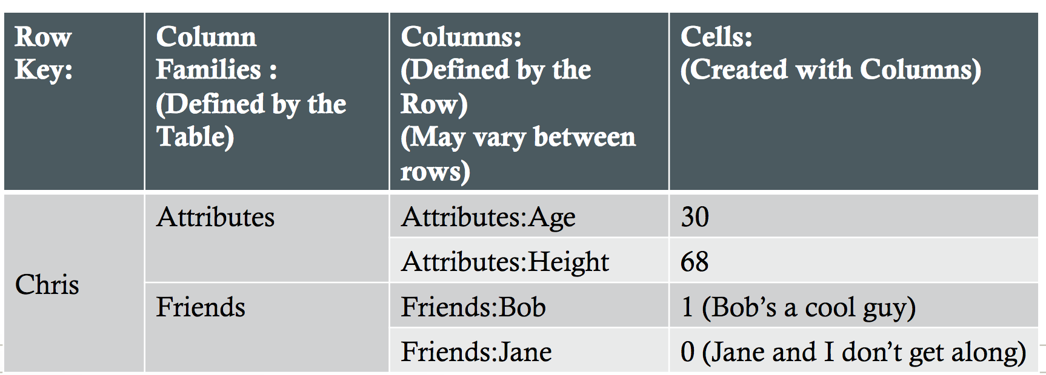
Rows and Cells
Not exactly the same as rows in a traditional RDBMS
RowKey: a byte array
Cells:, qualified by rowkey, column family, column, and timestamp (not shown here)

Slide 11
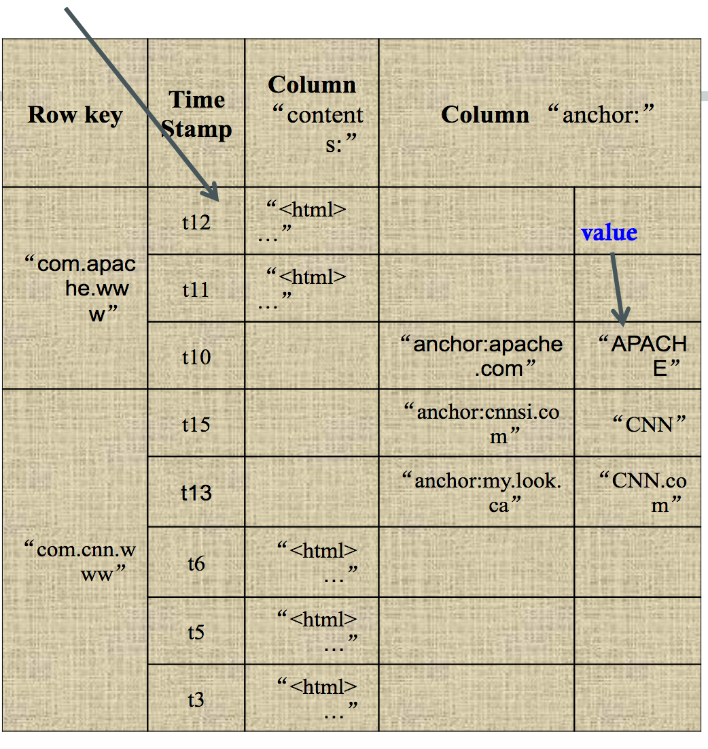
Cell Timestamps
All cells are created with a timestamp
Column family defines how many versions of a cell to keep
Updates always create a new cell
Deletes create a tombstone

Slide 12
HBase table’s mappings:
a row key maps to a list of column families
a column family maps to a list of column qualifiers (columns)
a column qualifier maps to a list of timestamps (versions)
a timestamp maps to a value (the cell itself)

Slide 13
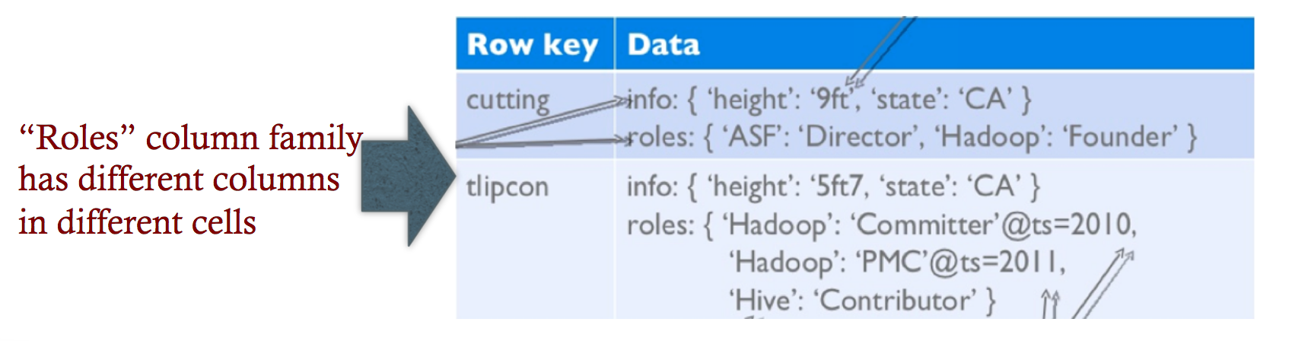
Notes on Data Model
HBase schema consists of several Tables
Each table consists of a set of Column Families
HBase has Dynamic Columns because column names are encoded inside the cells
Different cells can have different columns

Slide 14
Manipulating table data
Some operations:
Put Put either adds new rows to a table or can update existing rows.
Delete Delete one or more cells associated with particular row or remove entire row.
Get Basic “read” operation. Get can return entire row or some particular row columns.
Scan More advanced read operation. It provides a way to scan range of rows defined by start and end keys.

Slide 15
HBase Physical Model
Each column family is stored in a separate file
Key & Version numbers are replicated with each column family
Empty cells are not stored

Slide 16
HBase – Physical View
CF1
CF2
Row | C1 | C2 | C3 | C4 | C5 | C6 | C7
ROW1 | V1 |  | V3 |  |  | V6
ROW2 | V4 | V6 |  | V7
ROW3 |  |  | V6 |  |  | V5
ROW4 | V10 |  | V11 |  |  | V2
HFile for CF1
HFile for CF2
ROW1:CF1:C1:V1
ROW1:CF1:C3:V3
ROW2:CF1:C1:V4
ROW2:CF1:C2:V6
ROW2:CF1:C4:V7
ROW3:CF1:C3:V6
ROW4:CF1:C1:V10
ROW4:CF1:C3:V11
ROW1:CF2:C6:V6
ROW3:CF2:C6:V5
ROW4:CF2:C6:V2
Physical View

Slide 17
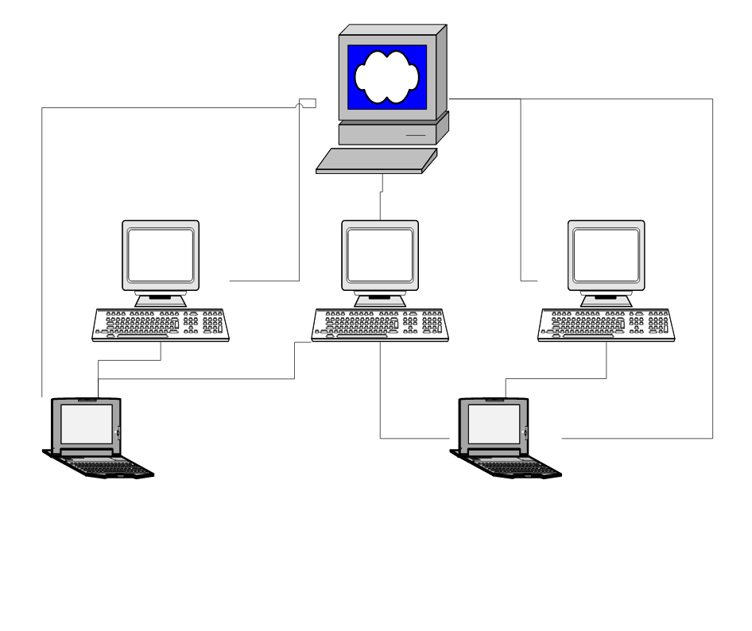
HBase Components
Region
A subset of a table’s rows, like horizontal range partitioning
Automatically done
RegionServer (many slaves)
Manages data regions
Serves data for reads and writes
Master
Responsible for coordinating the slaves
Assigns regions, detects failures
Admin functions

Slide 18
Regions & RegionServers
All HBase tables are broken into 1 or more regions
Regions have a start row key and an end row key
Each Region lives on exactly one RegionServer
RegionServers may host many Regions
When RegionServers die, Master detects this and assigns Regions to other RegionServers

Slide 19
Where we can use HBase?
For large data sets (millions or billions or rows and columns) and we require fast, random and real time, read and write access over the data.
The data sets are distributed across various clusters and we need high scalability to handle data.
The data is gathered from various data sources and it is either semi structured or unstructured data or a combination of all. It could be handled easily with HBase.
You want to store column oriented data.
You have lots of versions of the data sets and you need to store all of them.

Slide 20
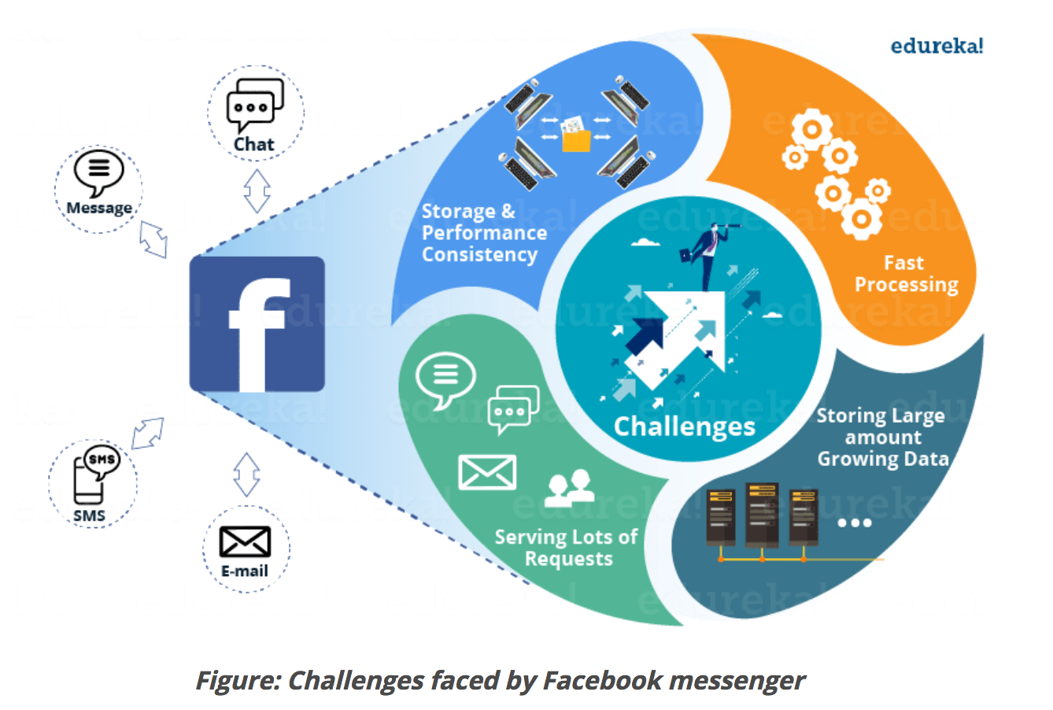
HBase: Facebook Messenger Case Study
Facebook Messenger combines Messages, email, chat and SMS into a real-time conversation.
A short set of temporal data that tends to be volatile
An ever-growing set of data that rarely gets accessed
The major problems were:
Storing the large sets of continuously growing data from various Facebook services.
Requires Database which can leverage high processing on it.
High performance needed to serve millions of requests.
Maintaining consistency in storage and performance.

Slide 21
HBase vs HDFS
HBase provides low latency access to small amounts of data within large data sets while HDFS provides high latency operations.
HBase supports random read and writes while HDFS supports WORM (Write once Read Many or Multiple times).
HDFS is basically or primarily accessed through MapReduce jobs while HBase is accessed through shell commands, Java API, REST, Avro or Thrift API.

Slide 22
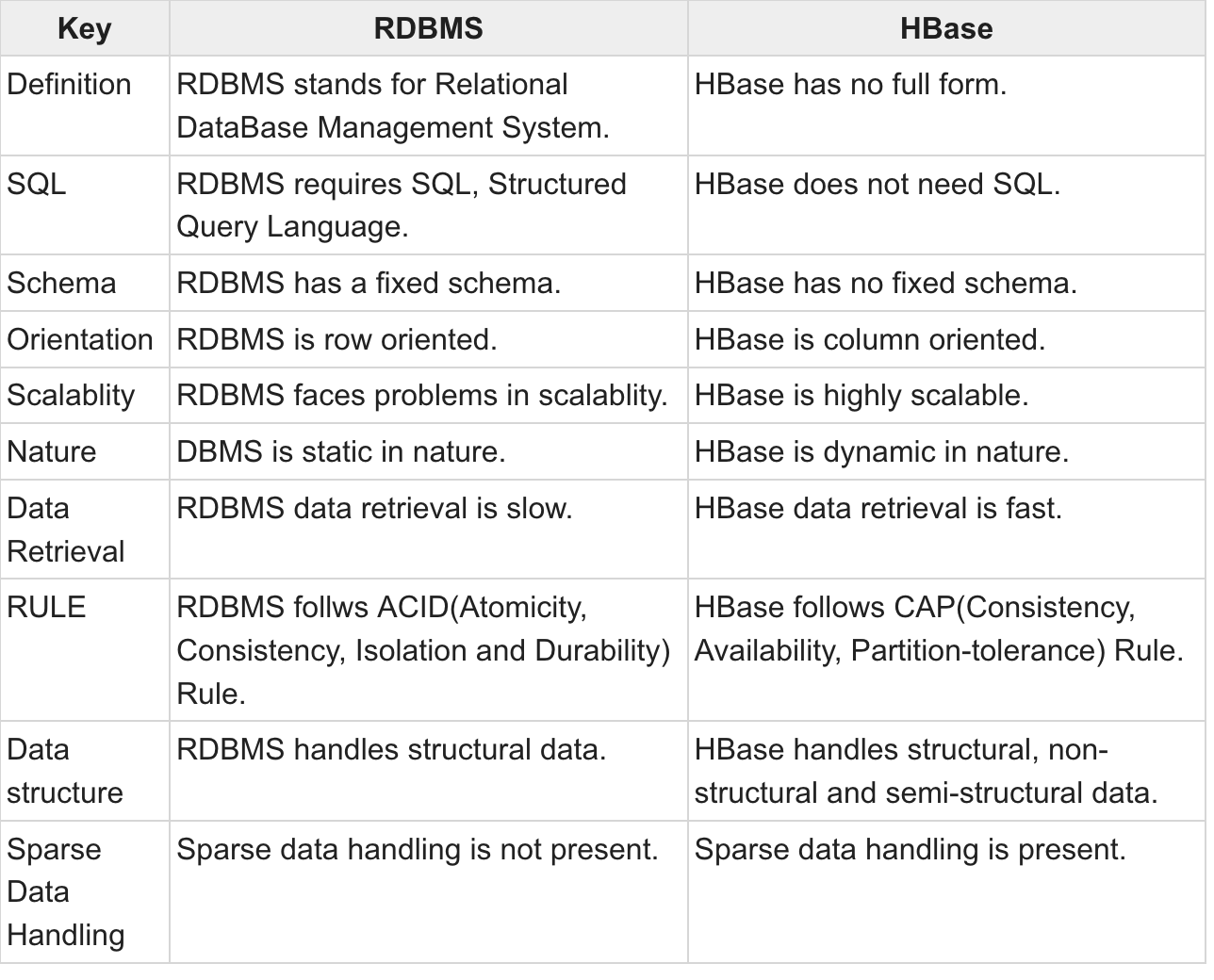
HBase vs RDBMS

Slide 23
What is Hive?
Hive is data warehousing solution developed on top of Hadoop to meet the big data challenges of storing, managing and processing large data sets without having to write complex MapReduce programs (in Java, Scala)
Hive is not a relational database or an architecture for online transaction processing (OLTP)
It is designed for online analytical processing systems (OLAP)
Notes:
OLTP has also been used to refer to processing in which the system responds immediately to user requests.
OLAP includes business reporting for sales, marketing, management reporting, business process management (BPM)

Slide 24
Hive
Hive compiler converts HiveQL (SQL like Dialect) into MapReduce jobs so that Hadoop developers do not need to do complex programming and can focus on the business problem
When a user submits a HiveQL query it is first compiled and this compiled query is then executed by an execution engine like Hadoop MapReduce or Apache Tez
Developed by Facebook

Slide 25
Motivation For Hive (i)
Growth of Facebook data warehouse
2007: 15 TB of net data
2010: 700 TB of net data
2011: > 30 PB of net data
2012: > 100 PB of net data
Scalable data analysis used across the company
Ad hoc analysis
Business intelligence
Insights for Facebook Ad Network
Analytics for page owners

Slide 26
Motivation For Hive (ii)
Original Facebook data processing infrastructure
Built using commercial RDBMS prior to 2008
Became inadequate as daily data processing jobs took longer than a day
Hadoop was selected as a replacement
Pros: petabyte scale and use of commodity hardware
Cons: using it was not easy for end user not familiar with MapReduce
“Hadoop lacked the expressiveness of query languages like SQL and users ended up spending hours (if not days) writing programs for simple analysis”

Slide 27
Motivation For Hive (iii)
Hive is intended to address this problem by bridging the gap between RDBMS and Hadoop
“our vision was to bring the familiar concepts of tables, columns, partitions and a subset of SQL to the unstructured world of Hadoop”
Hive provides
Tools to enable easy data extract/transform/load (ETL)
A mechanism to impose structure on a variety of data formats
A simple SQL-like query language
Query execution via MapReduce

Slide 28
Hive Usage At Facebook
Data processing tasks
More than 50% of the workload are ad-hoc queries
Types of applications
Summarization, e.g. daily/weekly aggregations of ‘click’ counts
Ad-hoc analysis, e.g. how many group admins broken down by state/country
Data mining, e.g. user engagement as a function of user attributes

Slide 29
Hive Client
Hive Clients - supports client application for performing queries written languages like Java, Python, etc using JDBC, Apache Thrift and ODBC drivers
Hive Services - Can be accessed from:
Command Line Interface (CLI)
Web Interface

Slide 30
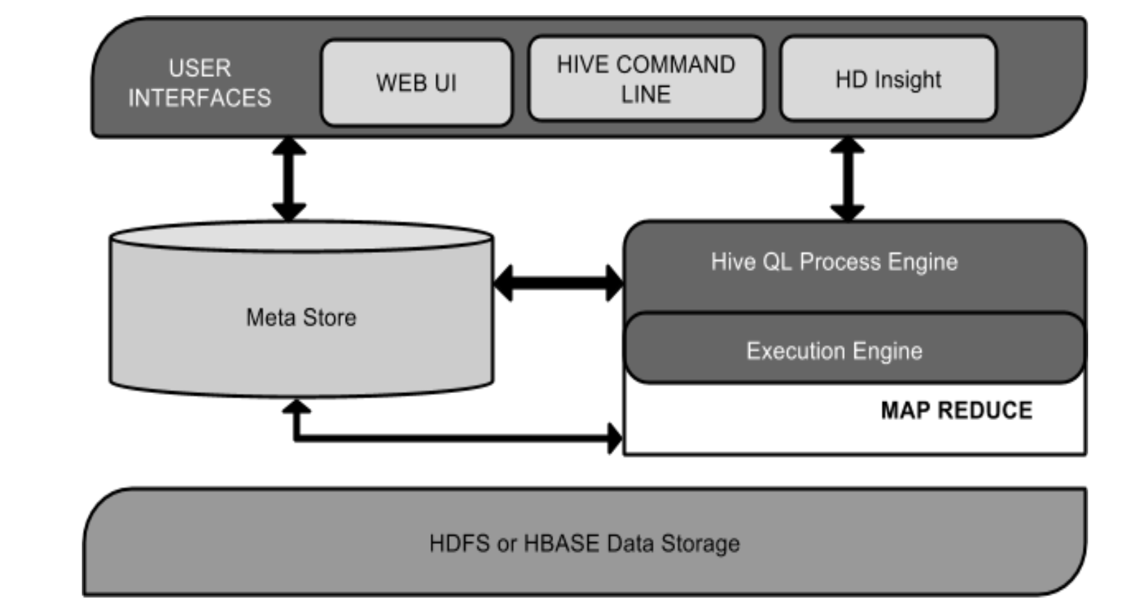
Architecture of Hive
User Interface
Meta store
store the schema or Metadata of tables, databases, columns in a table
HiveQL Process Engine
A query for MapReduce job
Execution Engine
Process the query and generates results
HDFS or HBASE
Store data into file system

Slide 31
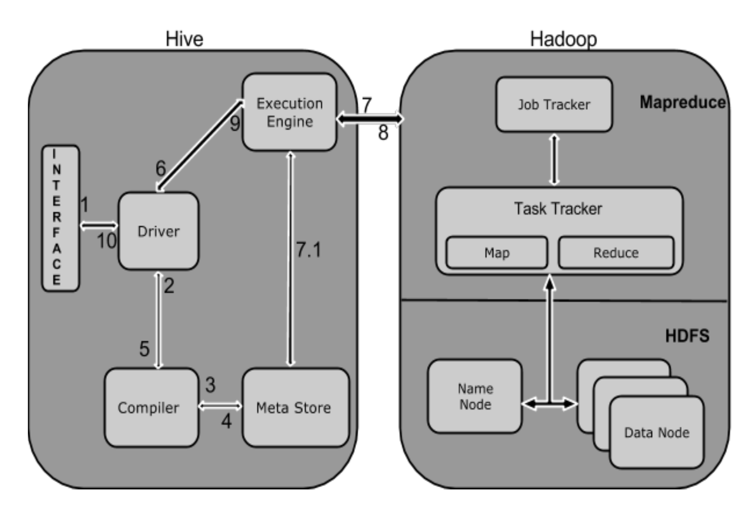
Workflow between Hive and Hadoop
Step | Operation
step1 | Send a query to Driver
step2 | Compile the query
step3 | The compiler sends metadata request to Metastore
step4 | Metastore sends metadata back
step5 | Resends the plan to the driver
step6 | The driver sends the execute plan to the execution engine.
step7 | Execute Job
step8 | Receives the results from Data nodes
step9 | Sends those resultant values to the driver
step10 | The driver sends the results to Hive Interfaces.

Slide 32
Hive VS RDBMS (I)
Hive is better described as data warehouse built on top of Hadoop, not full database
Hive is Write once, Read many times, but RDBMS is designed for Read and Write many times – RDBMS is mush more sophisticated (supports OLTP, OLAP)
In RDBMS updates, deletes, transactions and indexes (eg B & B+ Trees, etc) are possible. This is not fully supported in Hive as it was built to operate over HDFS data using MapReduce, where typically “full table” scans is how data is accessed and index use is limited
In RDBMS, maximum data size will be in 10’s of Terabytes range whereas Hive can 100’s Petabytes . Hive is very easily scalable at low cost but RDBMS not scalable & costly scale up.

Slide 33
Hive vs RDBMS (II)
Hive does not truly support OLTP (Online Transaction Processing) but closer to OLAP (Online Analytical Processing) but there is significant latency between posing a query and receiving a reply
Why is it slow?
RDBMS is better suited for dynamic data analysis and where fast responses are required. Hive is suited for data warehouse applications where relatively static data is analysed, fast response times are not required, and data not changing rapidly

Slide 34
Schema On Read vs Schema On Write
In a traditional RDBMS a table schema is enforced at load time
If the data being loaded does not conform to the schema it is rejected
Makes for faster queries as a result of possible optimisations
‘Schema on write’
Hadoop and Hive
Dump your data on the HDFS
Create your Hive table “over” your data
‘Schema on read’

Slide 35
HiveQL Overview
Working with Hive QL typically involves:
Creating a Hive table to hold a dataset to be queried
Populating table with a large dataset
Running HiveQL query against a table

Slide 36
Creating a Table
CREATE TABLE statement includes:
Table name
Column names and types
Input data format (e.g. comma separated)
Input file structure (e.g. each record on a new line)
hive> CREATE TABLE books (ISBN STRING, title STRING, author STRING, > year INT, publisher STRING, price DOUBLE)
> ROW FORMAT DELIMITED
> FIELDS TERMINATED BY ‘,’
> STORED AS TEXTFILE;
Semicolon terminates statement
Tables currently available in Hive can be displayed by running
hive> SHOW TABLES;

Slide 37
Hive vs. HBase - Difference between Hive and HBase
Hive is query engine that whereas HBase is a data storage particularly for unstructured data.
Apache Hive is mainly used for batch processing i.e. OLAP but HBase is extensively used for transactional processing wherein the response time of the query is not highly interactive i.e. OLTP.
Unlike Hive, operations in HBase are run in real-time on the database instead of transforming into mapreduce jobs.
HBase is suitable for real-time querying and Hive is is suitable for analytical queries.

Slide 38
Thanks!

